Slide 1


Candidate Name: Bhavishya Dhiman (RA1911033010056)
College Name: SRM Institute of Science and Technology, KTR
Email: bd4874@srmist.edu.in
Phone No.: 9205630114
Chosen Problem statement: E-Commerce Data

Slide 2

Understanding of the problem statement
Key Metrics to be found and Analyzed : -
We were given an e-commerce sales dataset with 3 csv files –
1.List of Orders - This dataset contains purchase information. The information includes ID, Date of Purchase and customer details
2.Order Details - This dataset contains order ID, with the order price, quantity, profit, category and subcategory of product
3.Sales target - This dataset contains sales target amount and date for each product category
Our Job ( acting as a business manager) was to find out the key metrics as asked in the problem statement and analyze the data based on those key metrics. and then report our findings after thorough analysis of those metrics.
Sales Trend Analysis - Trend analysis is to find patterns in data, such as ups & downs. A “trend” is an upwards or downwards shift in a data set over time. Bring out below analysis under Trend Analysis
Profit over a period (monthly)
Profit Trend Analysis
Profit by State
Which customer need to be focused
Which category/sub-category contributing more to the company
Sales Target Analysis - A sales target is a goal set for a salesperson or sales department measured in revenue or units sold for a specific time.
Analyze Target and the Actual amount of Profits and find out which category meet the surpass the target
Which months did they hit the sales target?
If Any other analysis based on data?
Correlation matrix for Order details?
All these have been discussed in further sections of the report .

Slide 3
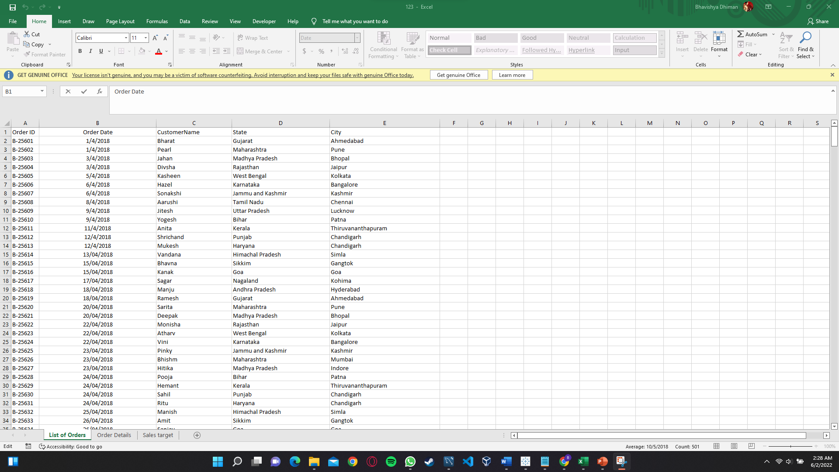
Approach (different approaches taken and algorithms)
Converted dates to a standardized format : -
Software’s Used :- MS Excel, MySQL workbench and Tableau (Majorly used)
-The first and most important task when we start to analyze data is Data cleaning. I cleaned the data using the help of above mentioned software’s.
-Searched for duplicate values, irrelevant observations, structural errors or missing data in the given data set.
-Standardized all the dates by changing there format into one single uniform format using excel. the ListOfOrders.csv file so that there wont be any confusion in the further steps.
- Imported the data to MySQL workbench
-Profit was given as negative at many places, obviously any company wont be selling there products at negative profits. So I considered this as a flaw in the data. Fixed this inconsistency by adding a constraint that profit needs to be at least 1 or greater.

Slide 4
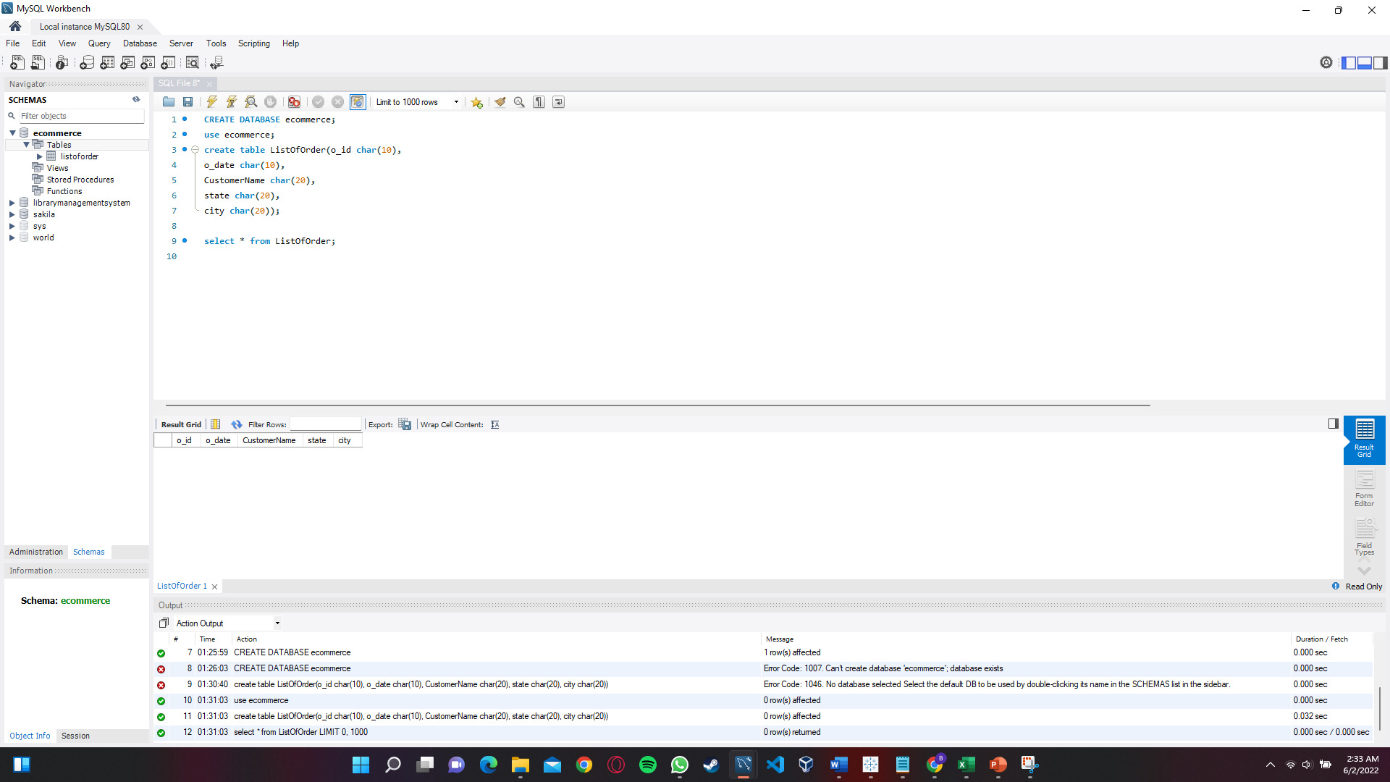
Steps Taken (flow of steps to solve the problem)
Some dates were given in wrong formats.
Profit at least needs to be 1 or greater.
One thing I was wondering, if the order ID , Category and Subcategory are same then why are the profit and quantity values differing. This can be a case of inconsistency in the dataset which needs to be cleaned.
Using MySQL workbench to further clean and organize the data given :-
.
.
.
.
After this exported the data to Tableau for finding key metrics and gaining potential insights about the business.

Slide 5
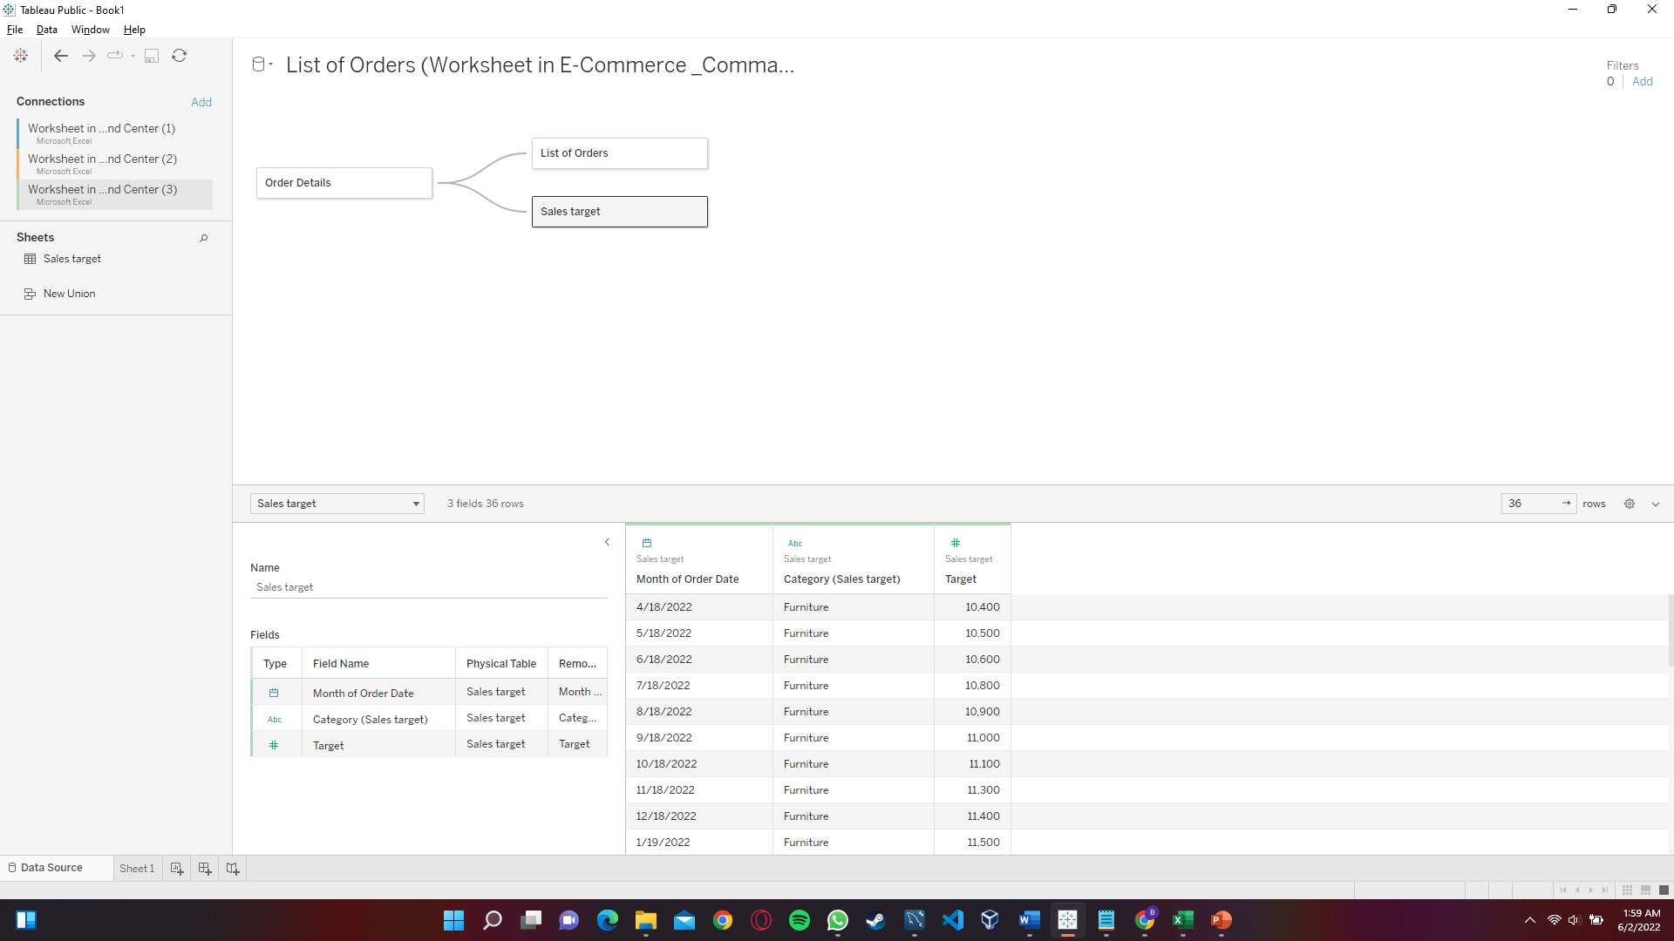
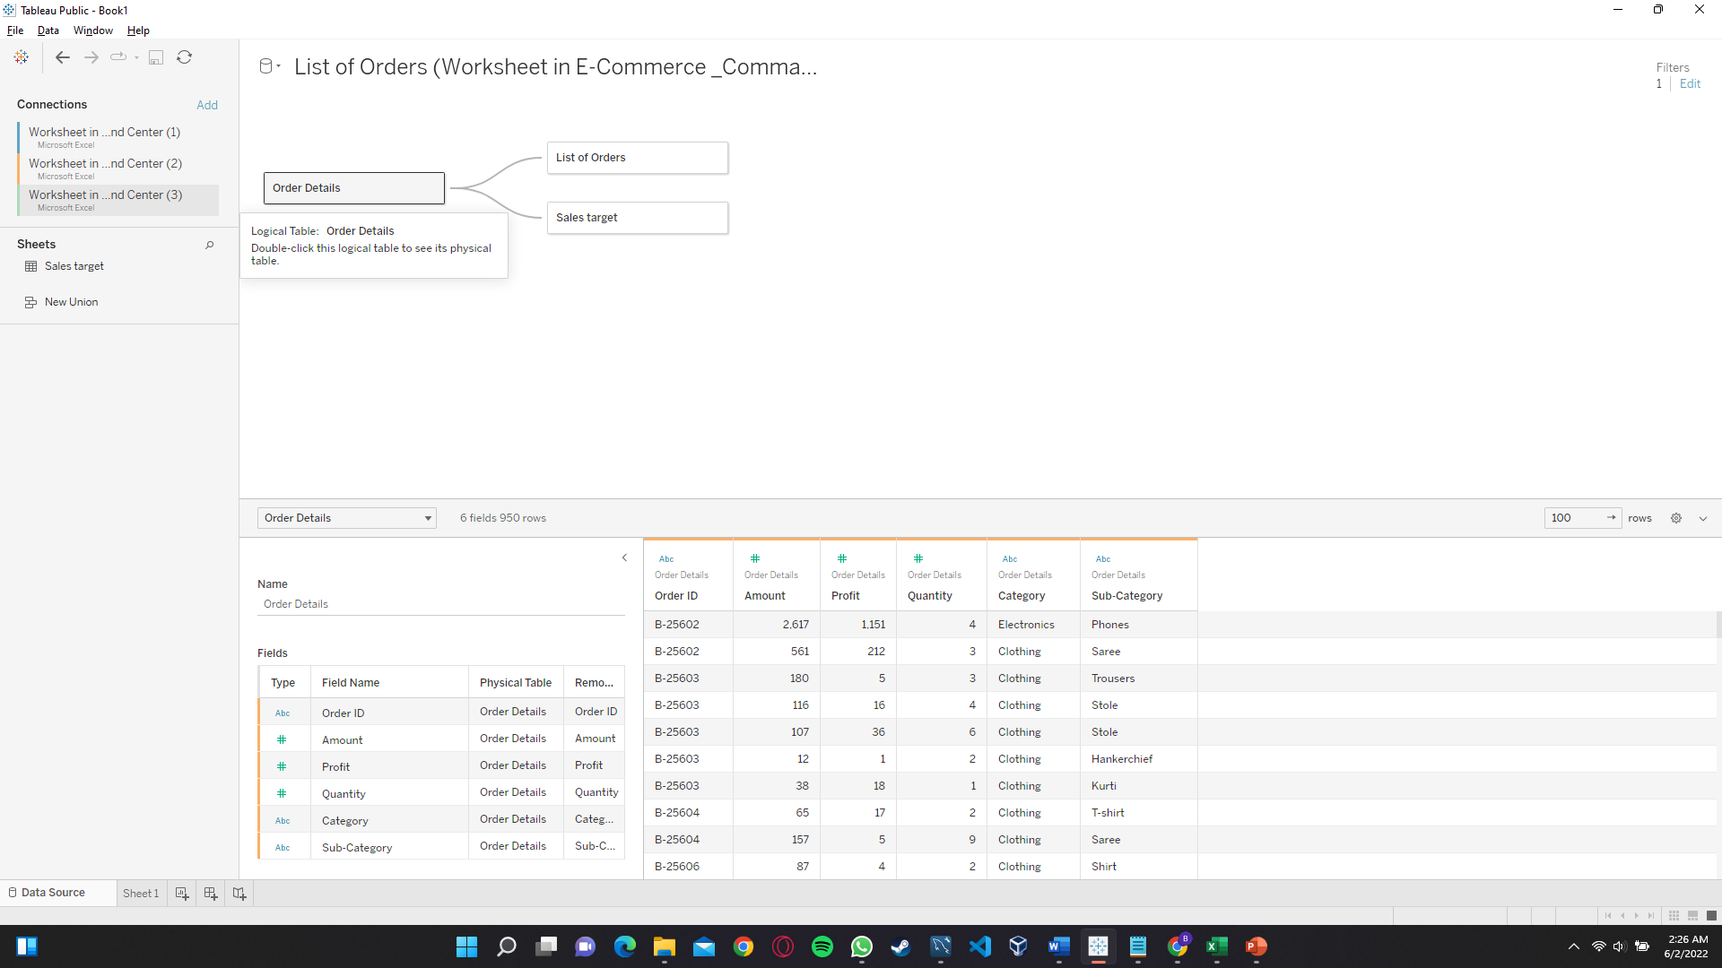
Used Tableau to visualize and find key metrics : -

Slide 6
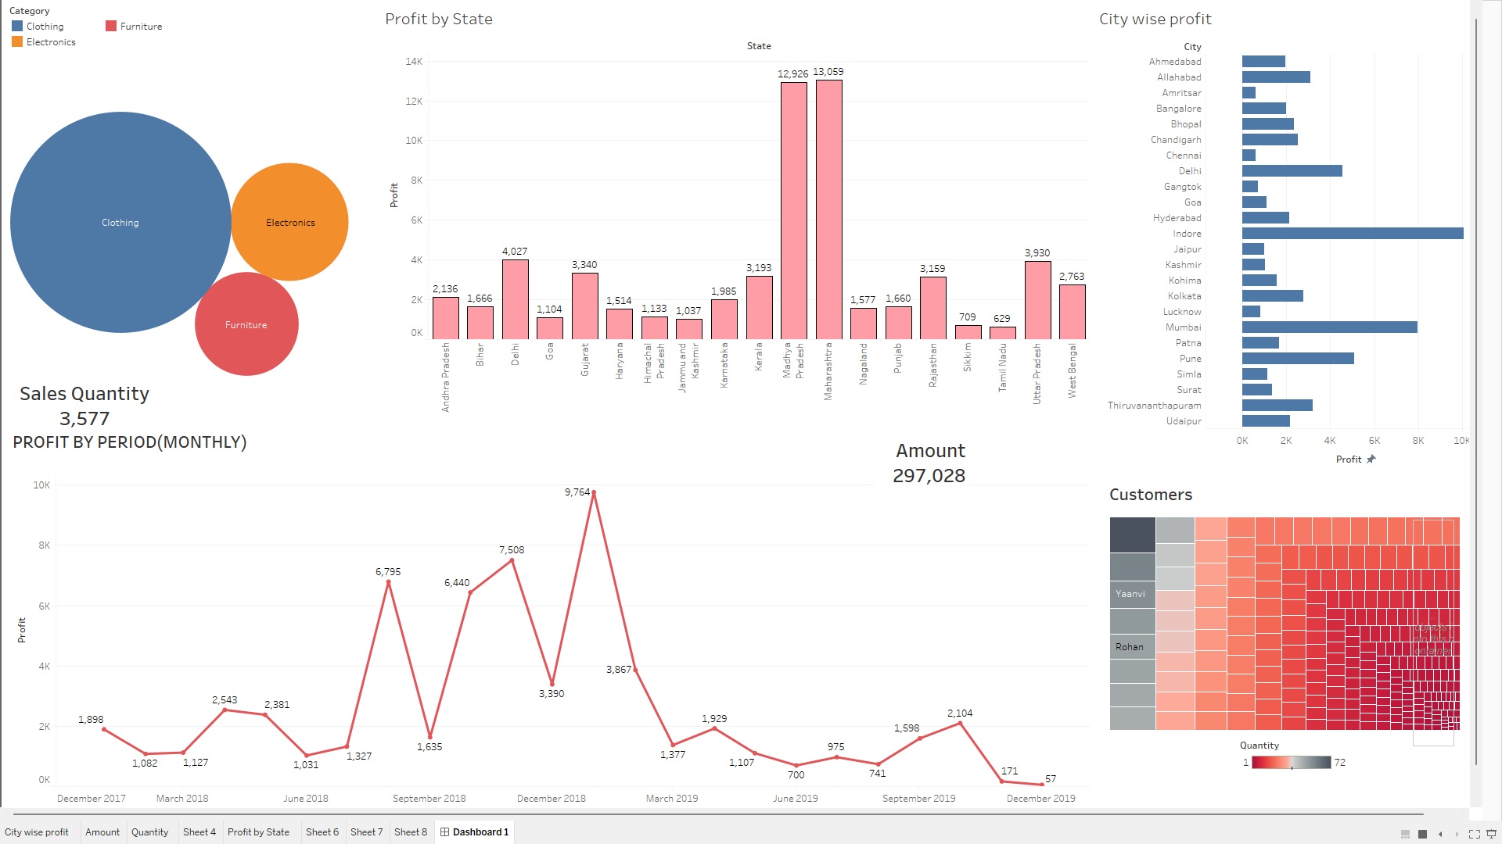

Slide 7
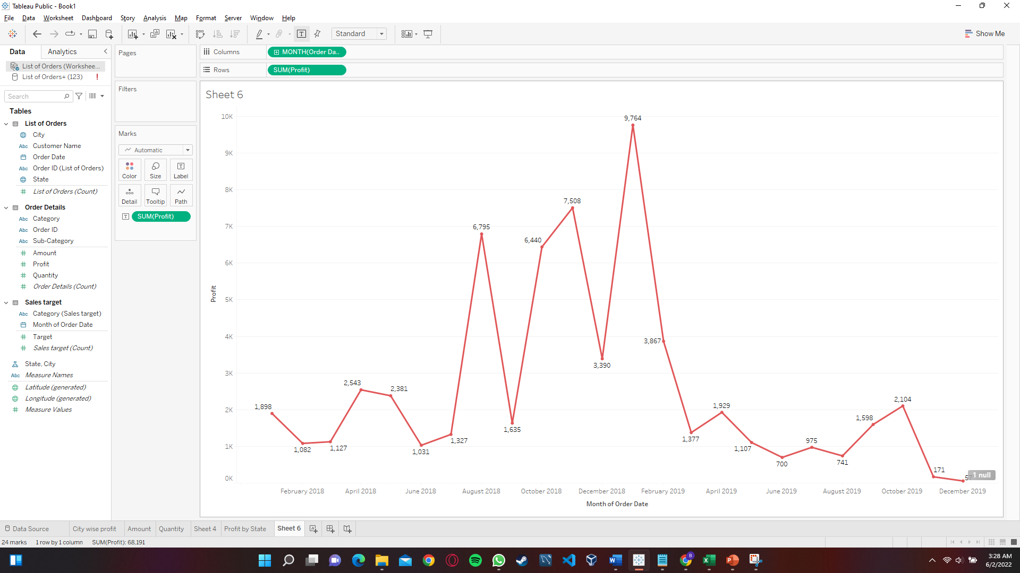
Sales Trend Analysis : -
1.Profit over a period (monthly)
According to this graph the company flourished and achieved huge profits in the months of February 2019, November 2018 and August2018.
Its sales profit margin dropped and took a huge hit from the starting of April 2019.

Slide 8
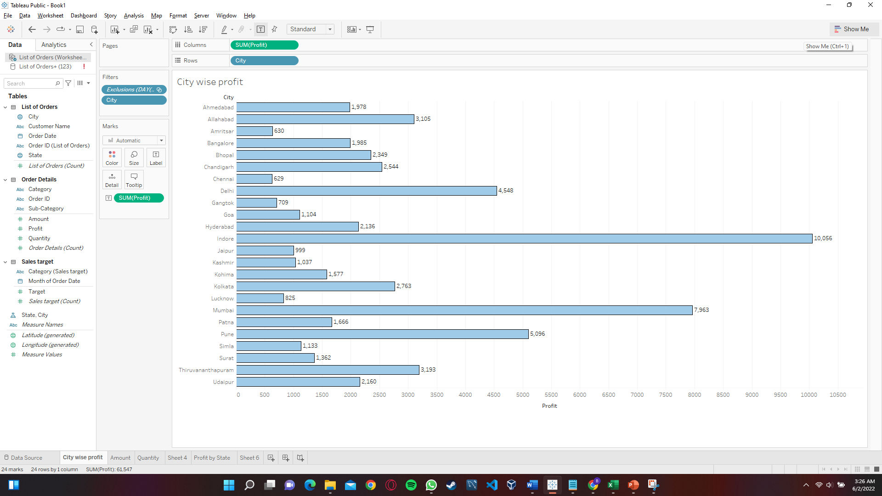
Sales Trend Analysis : -
2.Profit by city
Form the bar graph we can clearly incur that Indore, Mumbai and Delhi were the most profitable cities for the company.
This shows that the company needs to focus on other cities which do not generate the desired revenue. Such as Amritsar, Gangtok, Shimla, etc.

Slide 9
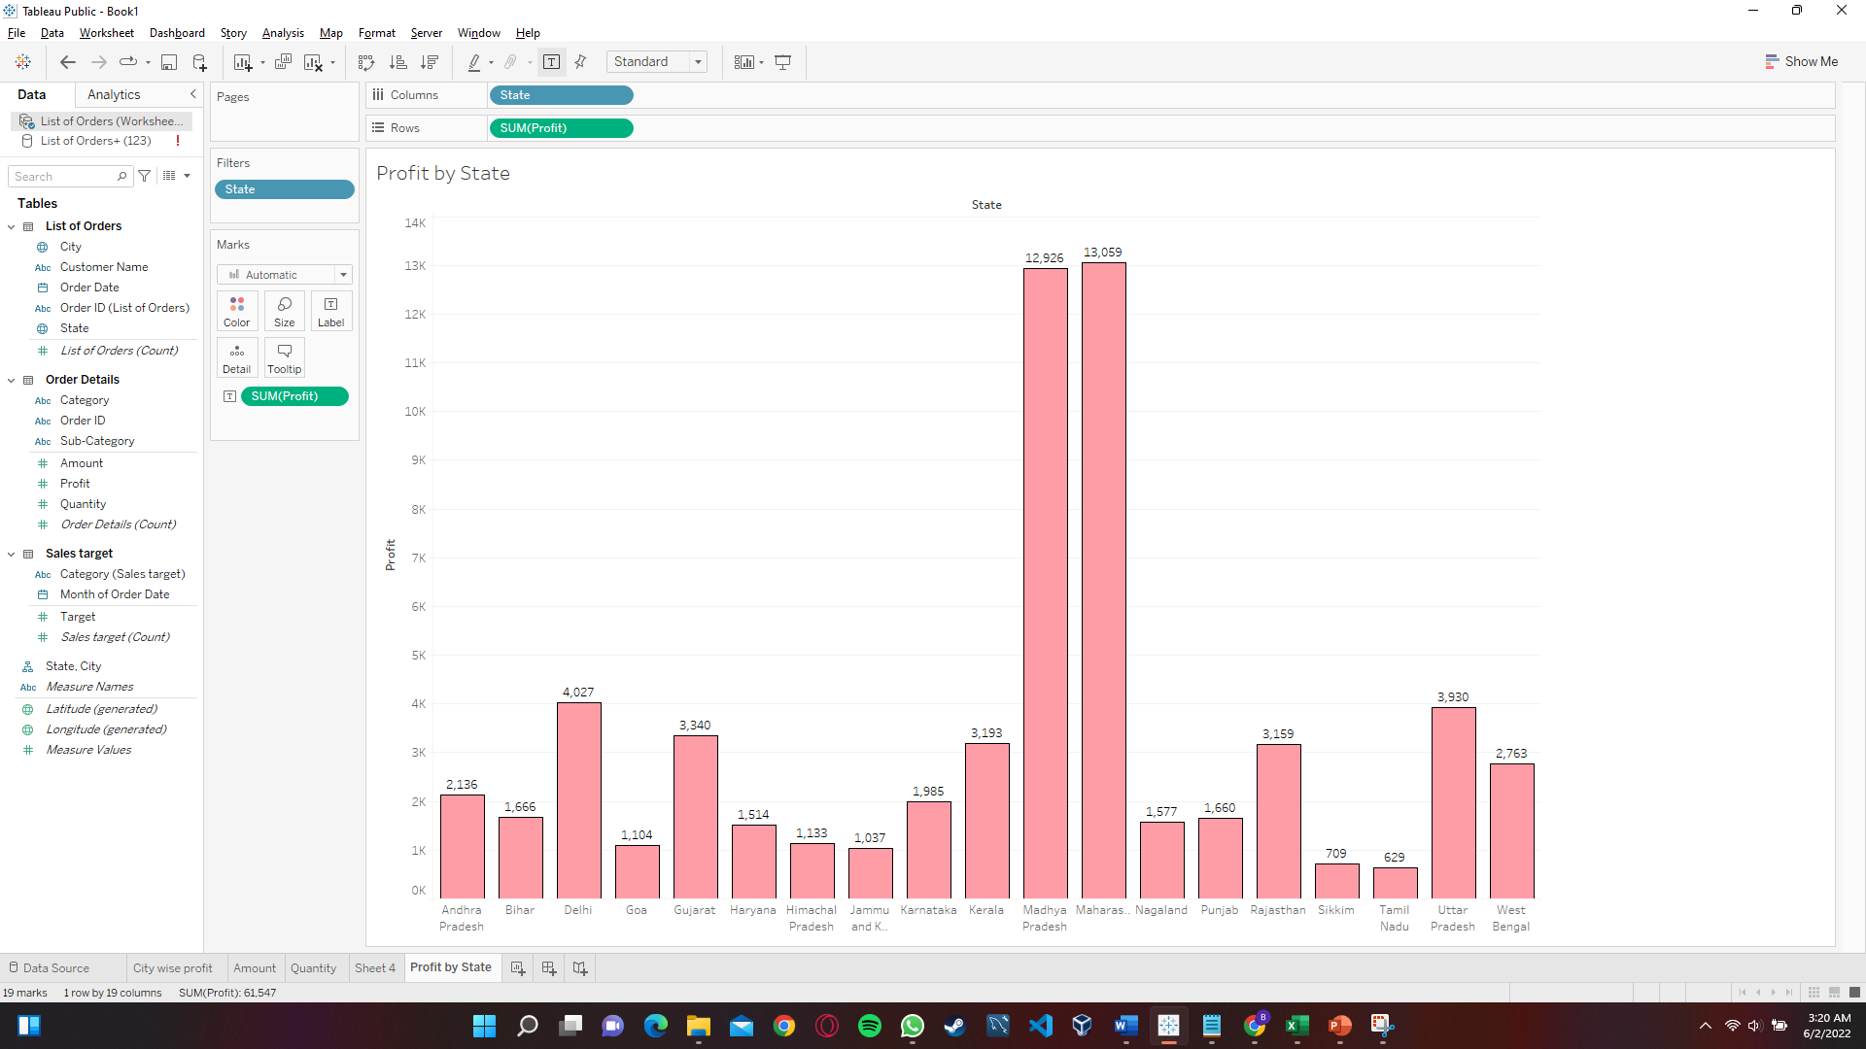
Sales Trend Analysis : -
2.Profit by state
Form the bar graph we can clearly incur that Maharashtra accounted for the most profit when it comes to states, followed by Madhya Pradesh
This shows that the company needs to focus on other states which do not generate the desired profits. Such Goa, Tamil Nadu, Sikkim etc.

Slide 10
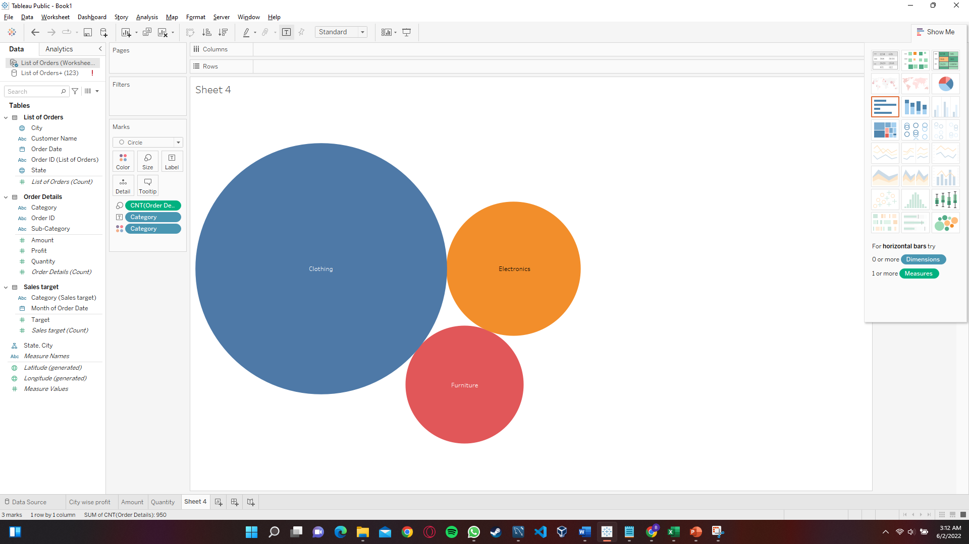
Sales Trend Analysis : -
3. Category wise contribution towards the company
Clothing items are the most in demand.
followed by electronics and then furniture.

Slide 11
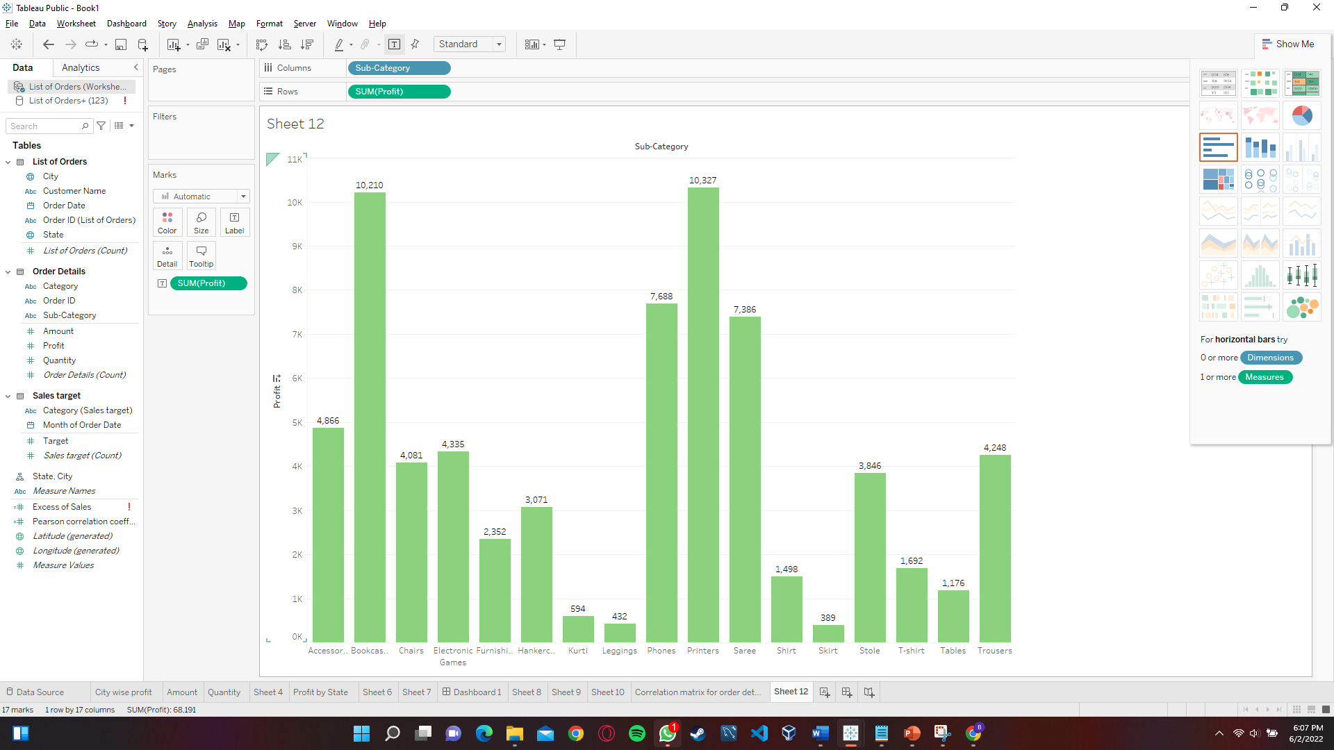
Sales Trend Analysis : -
4. Sub-Category wise contribution towards the company
Printers and bookcases account to the most profitable items sold by the company.

Slide 12
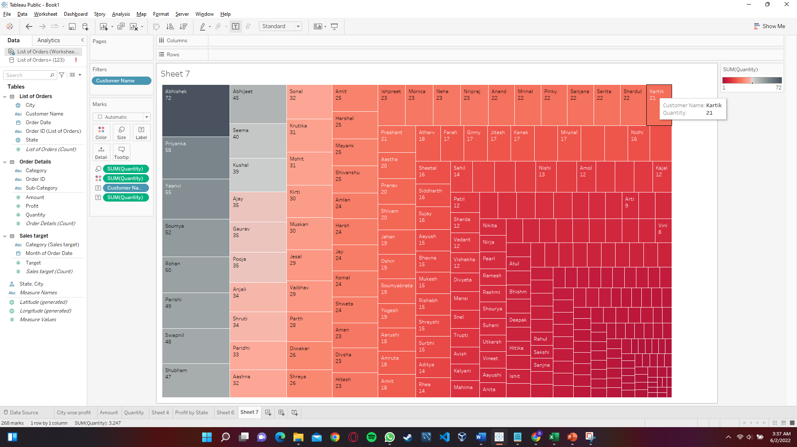
Sales Trend Analysis : -
5. Customers need to be focused
Customers in the bottom right region of the treemap need to be focused upon as they are the least engaged customers to the company.
While the ones in the darker top left region are the most loyal to the company's products.

Slide 13
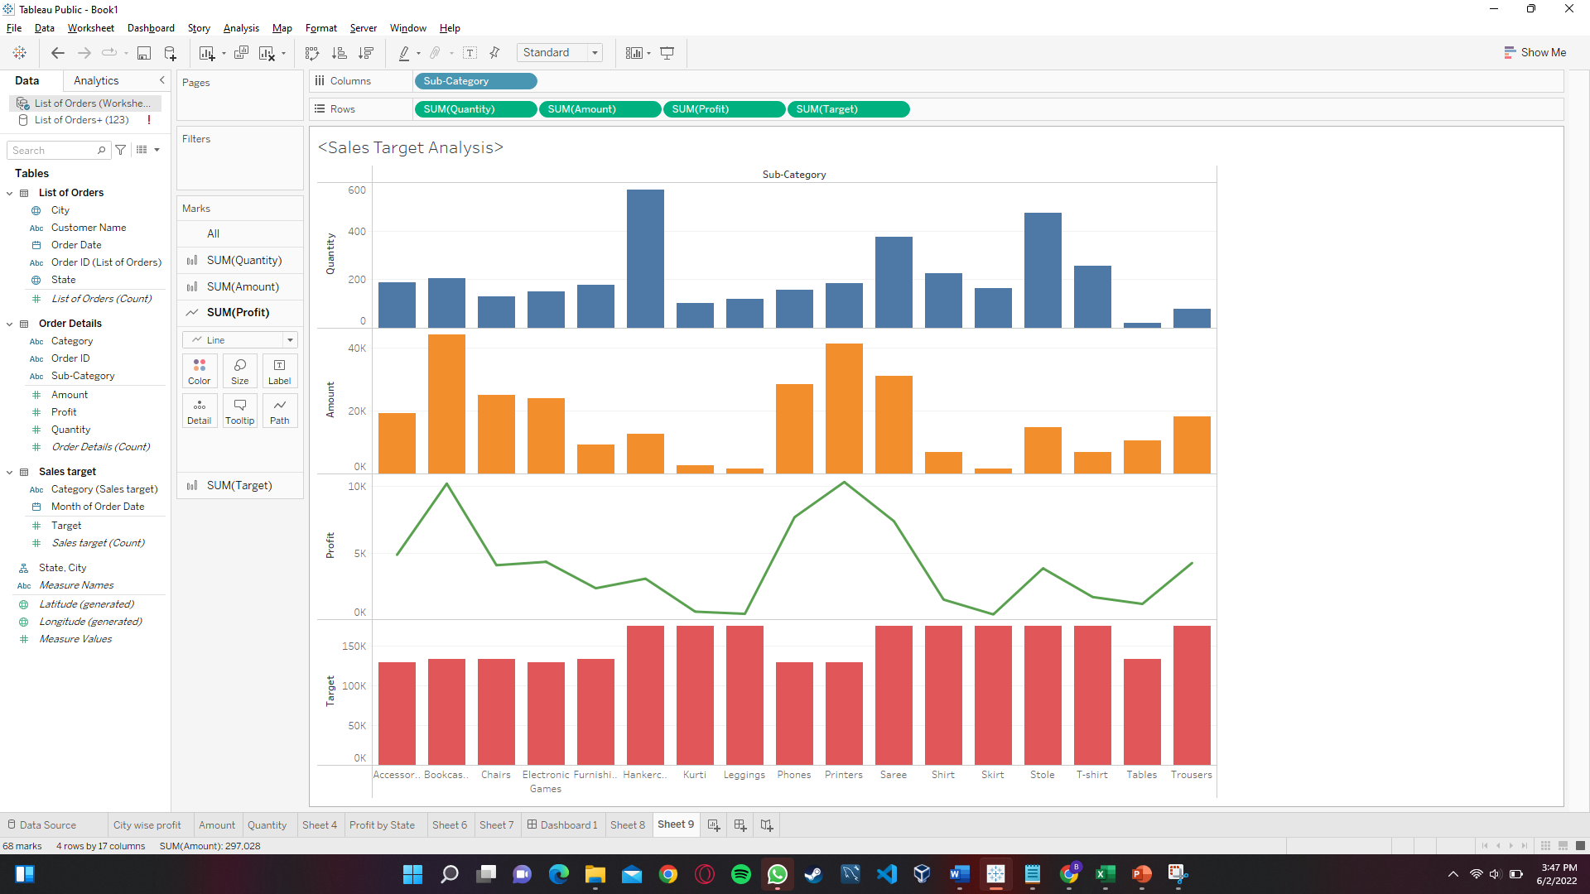
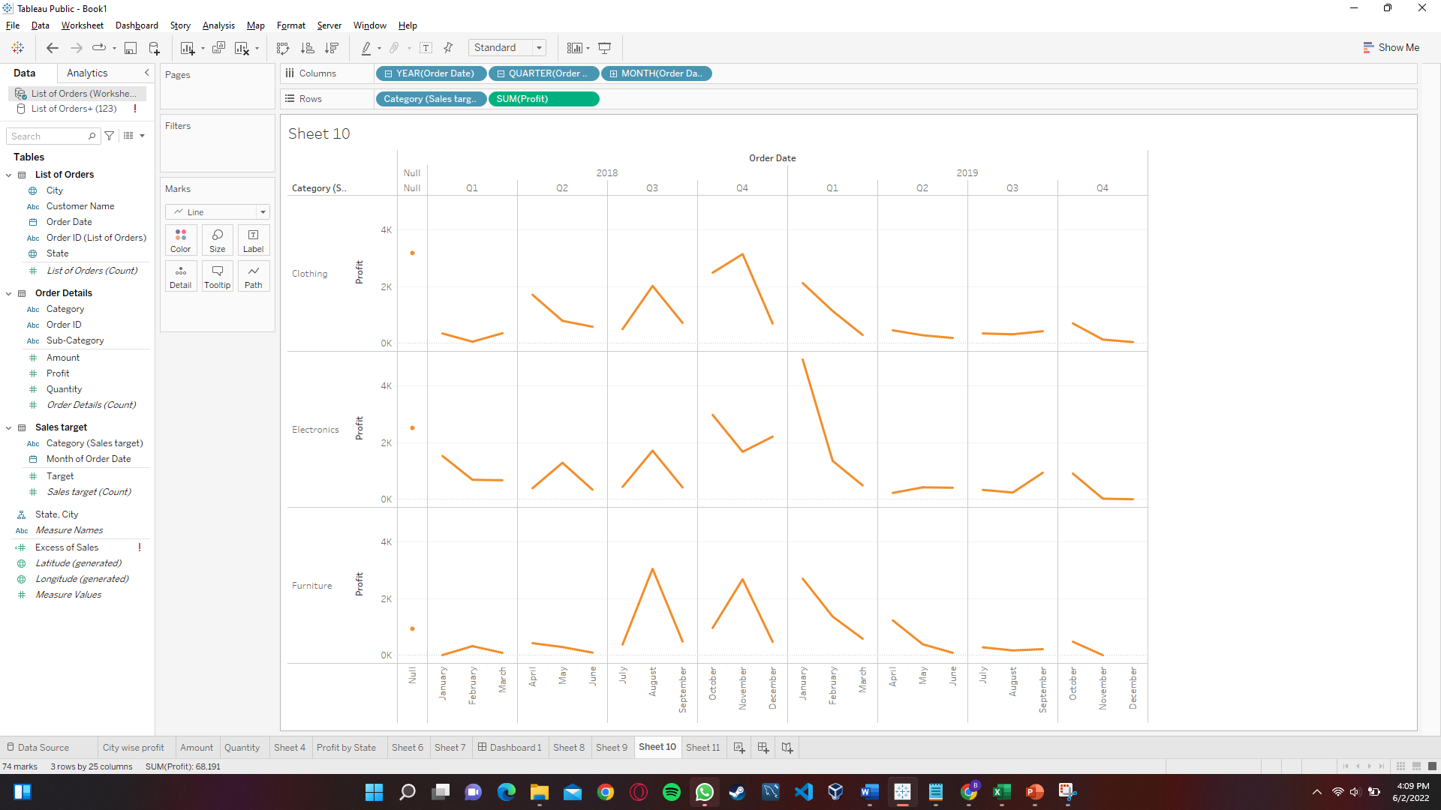
Sales Target Analysis : -
The term 'sales analysis' generally refers to the analysis of specific trends or components impacting a company's sales operations. Different analyses provide unique insight into the strengths and weaknesses of a company's sales team, sales management, individual sales reps, or overall sales strategy.

Slide 14
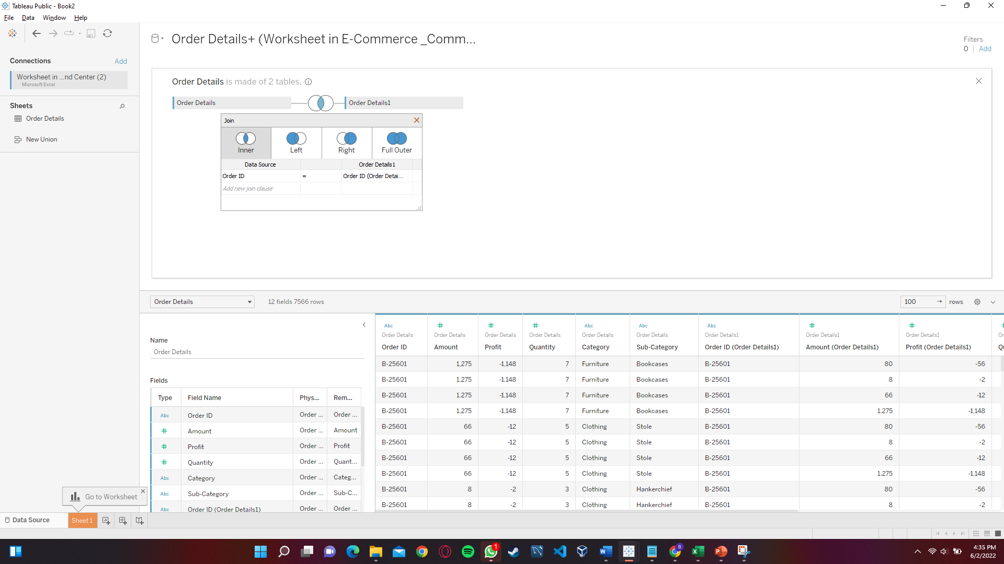
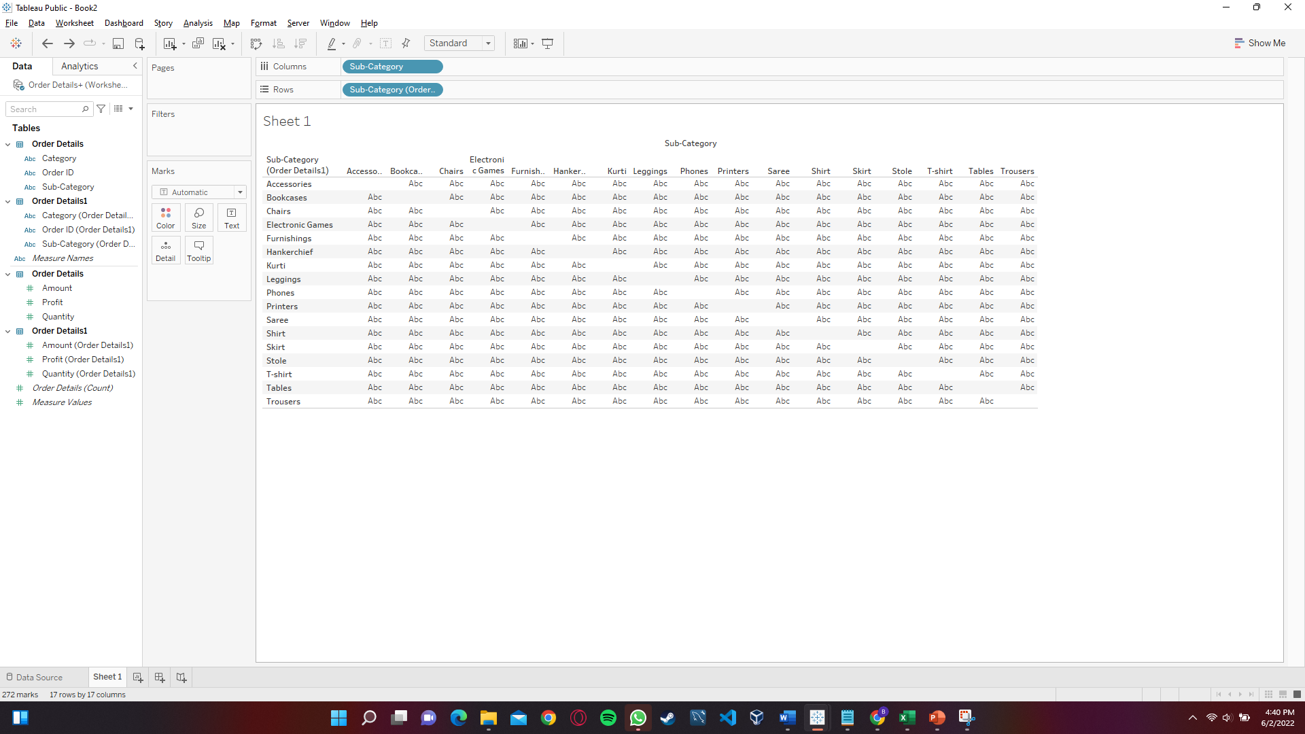
Correlation matrix for Order details :-
A correlation matrix is a table showing correlation coefficients between variables. Each cell in the table shows the correlation between two variables. A correlation matrix is used to summarize data, as an input into a more advanced analysis, and as a diagnostic for advanced analyses.

Slide 15
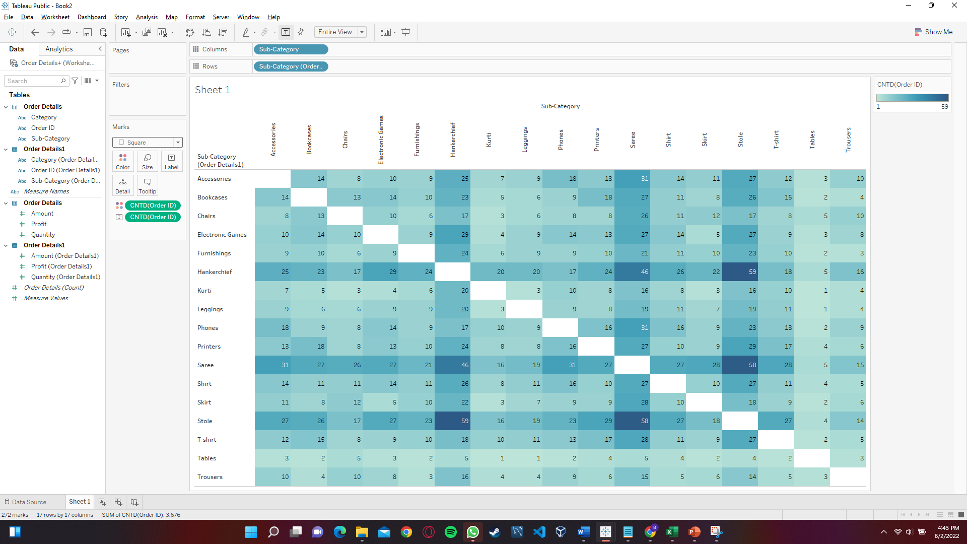
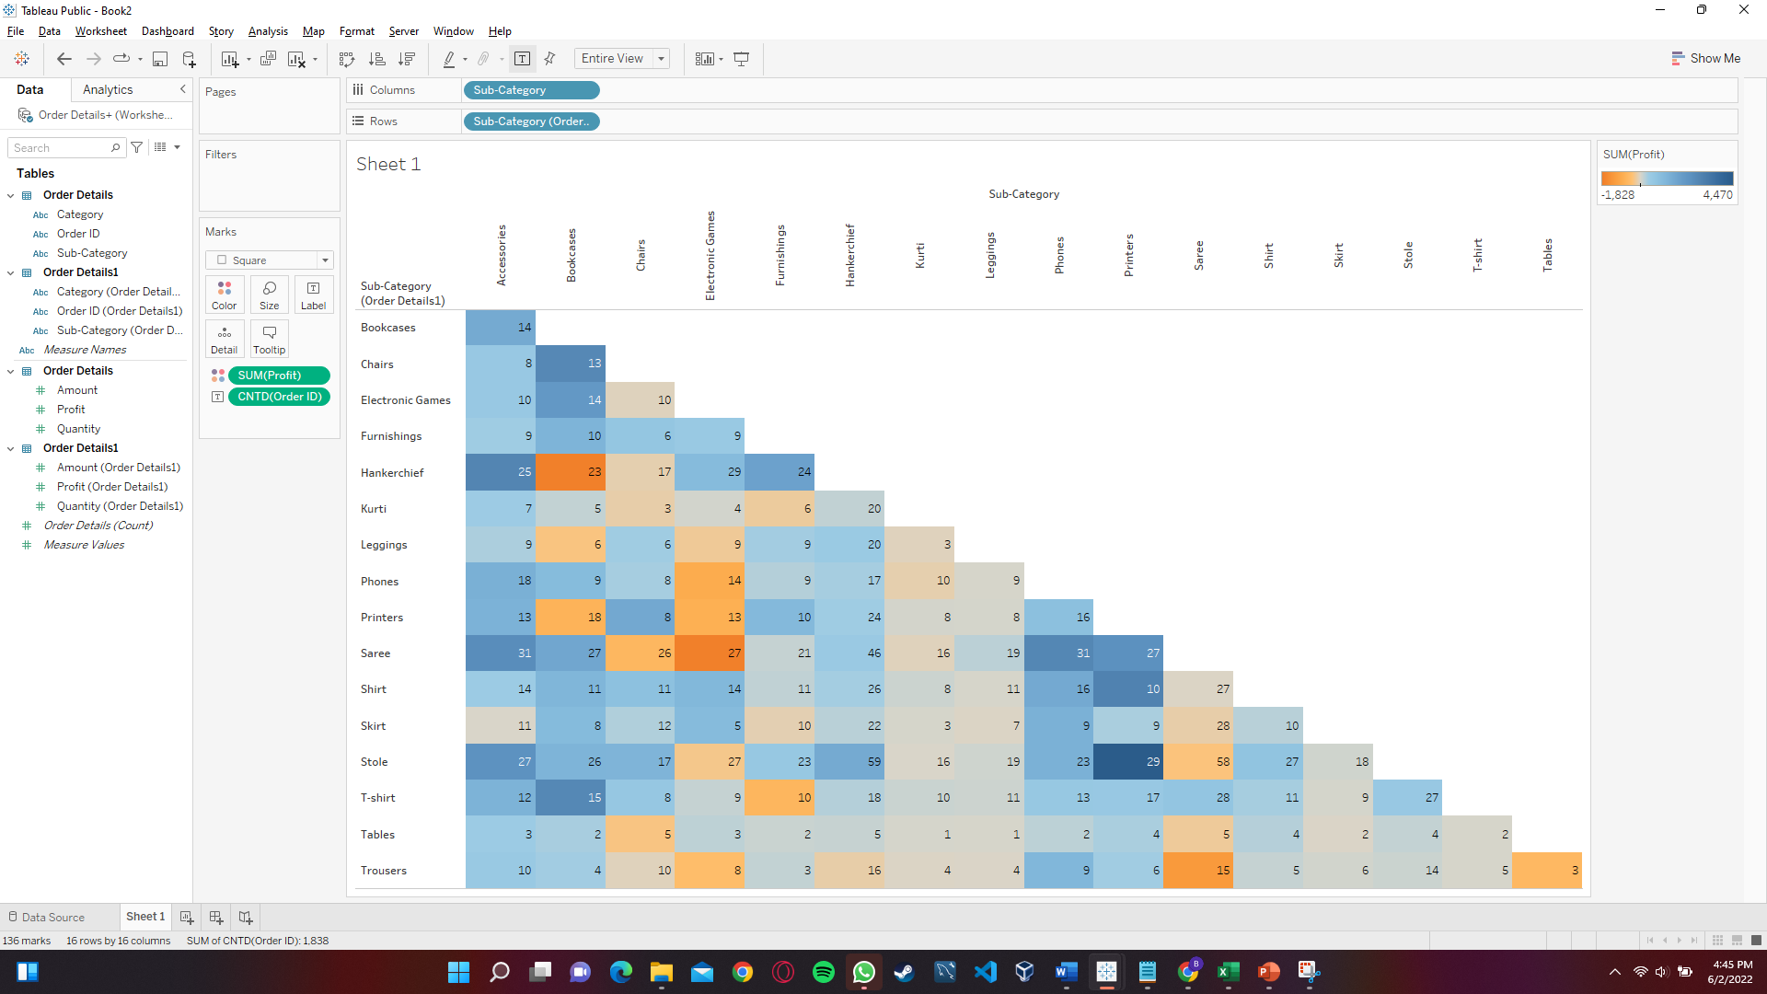
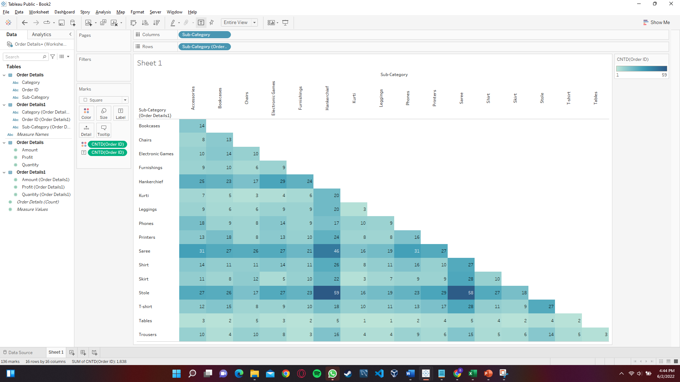
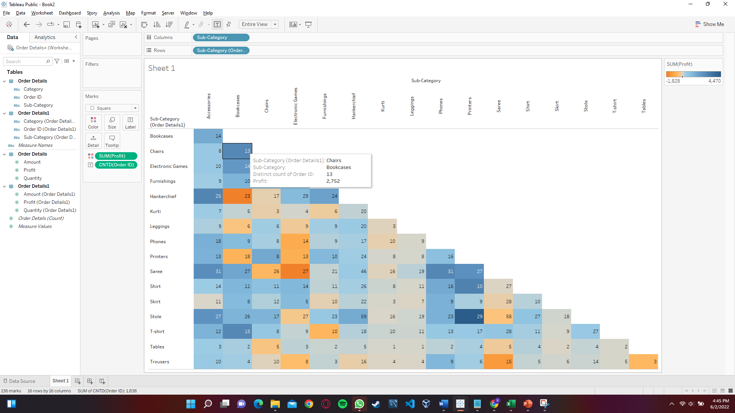

Slide 16
Applications of a correlation matrix in our case :-
To summarize a large amount of data where the goal is to see patterns. In our example above, the observable pattern is that all the variables highly correlate with each other.
To input into other analyses. For example, people commonly use correlation matrixes as inputs for exploratory factor analysis, confirmatory factor analysis, structural equation models, and linear regression when excluding missing values pairwise.
As a diagnostic when checking other analyses. For example, with linear regression, a high amount of correlations suggests that the linear regression estimates will be unreliable

Slide 17


Any other analysis based on data? :-
We can further do in-depth predictive analysis on the raw data given to us. Its not always accurate but can give us the competitive edge we need in todays world.
predictive analysis is where many organizations begin show signs of difficulty. Some companies do not have the manpower to implement predictive analysis in every place they desire. Others are not yet willing to invest in analysis teams across every department or not prepared to educate current teams.
Risk assessment and Sales forecasting analysis can be done from the data.
Use of advanced algorithms and scripts require time and manpower and hence this case study is limited to much more traditional and simpler approaches used in day to day life by a common data analyst.
This Photo by Unknown Author is licensed under CC BY-NC

Slide 18
Final Conclusion of this case study: -
If you find yourself in the middle of the fierce eCommerce market battlefield, one of the main questions you should ask your team is: how do we stay ahead as an online retailer?
Creating a proper and efficient data infrastructure for E-Commerce analytics is definitely one of the ways you can acquire the information you need to make the right decisions and steer your business in the right direction.
Using an efficient and powerful data visualization tool, such as Tableau, can simplify and shorten the path that our data needs to take to become useful insights.
The earlier we start this journey, the sooner we will reach a point where we know more than our competitors, and can outplay them in this tough game of life and business. I hope that this case study helped us to understand what all is needed to establish a successful E-commerce organization.
Although this case study has some limitations and is only a brief outline of what all insights we can gather from simple raw data. It can still be used to increase the efficiency and growth of our company, by working & improving on specific areas.

Slide 19
Thank You

